Slide 1
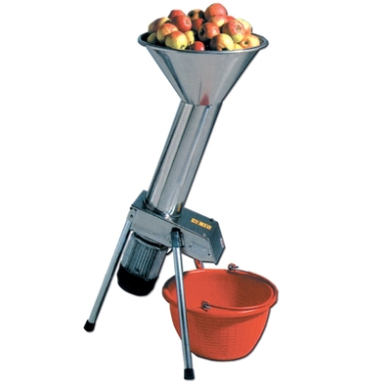
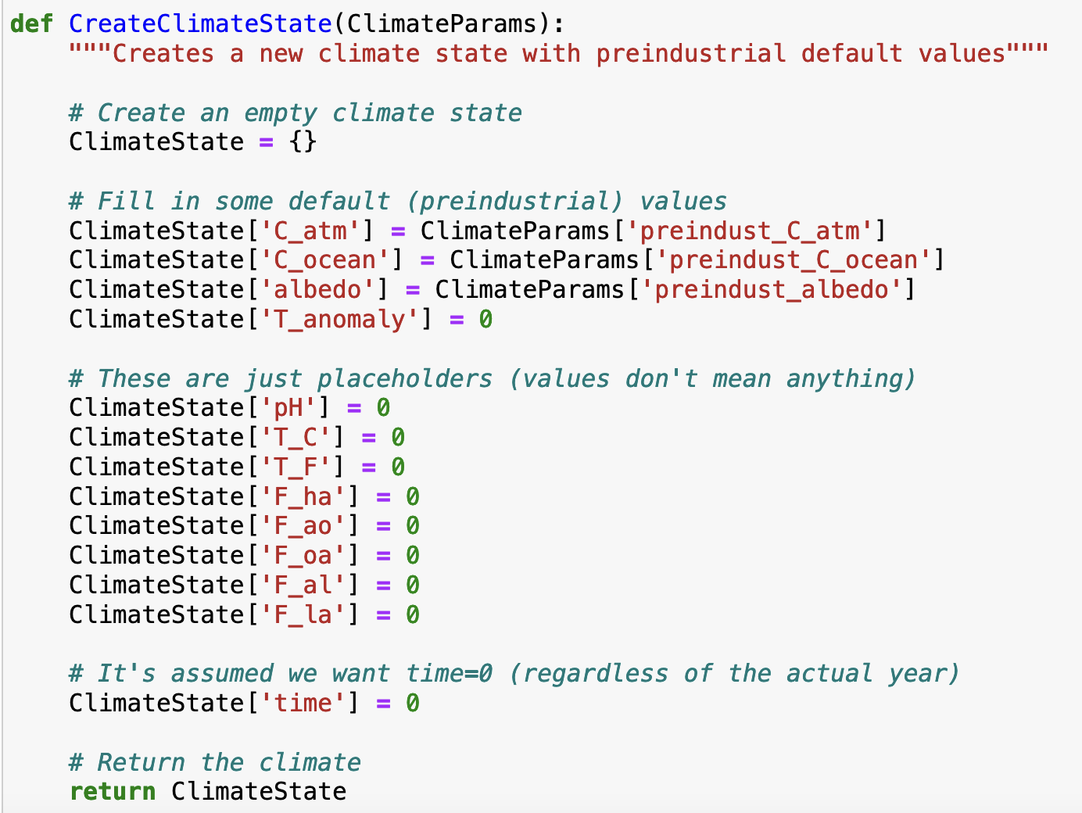
Python functions
In the code below, which corresponds to the apples?

Slide 2
Python functions
In the code below, which corresponds to the grinder?

Slide 3
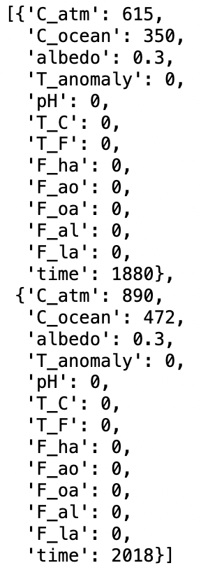
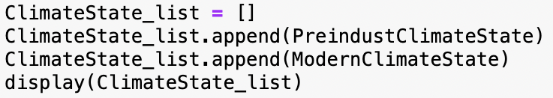

Dictionaries and lists
This code would produce which output?
A
B
C
D

Slide 4
pH scale 1
Battery acid
Approximately what pH characterized oceans in pre-industrial times?
Sodium hydroxide (active ingredient in DranoTM)

Slide 5
pH scale 2
Battery acid
How does the current ocean pH differ from pre-industrial times?
Sodium hydroxide (active ingredient in DranoTM)

Slide 6
pH scale 3
Battery acid
What pH results when you bubble CO₂ through water in the lab?
Sodium hydroxide (active ingredient in DranoTM)

Slide 7
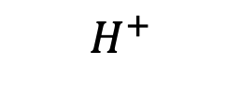
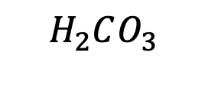
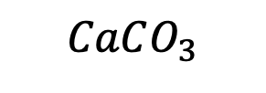
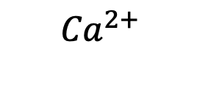
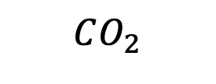
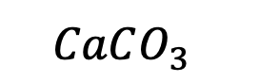
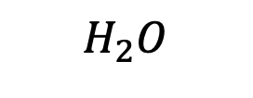
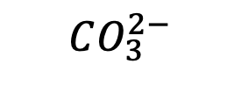
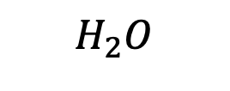
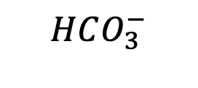

Carbonate reactions
When calcium carbonate (chalk) at the sea floor dissolves in the water …
it amplifies ocean acidification
it counteracts ocean acidification
it has no effect on the ocean’s acidity
Air
$$CO_{2}$$
$$H_{2}O$$
$$H_{2}O$$
Oceans
$H_{2}CO_{3}$
$$H^{+}$$
$$H^{+}$$
$$HCO_{3}^{−}$$
$${Ca}^{2+}$$
$$CO_{3}^{2−}$$
Sea floor
$$CaCO_{3}$$
$$CaCO_{3}^{}$$

Slide 8
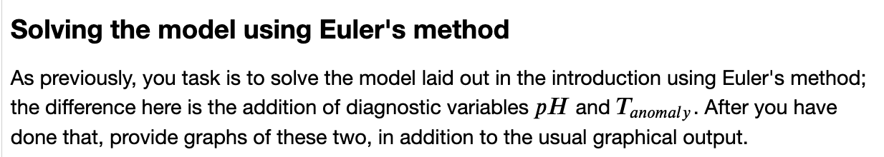
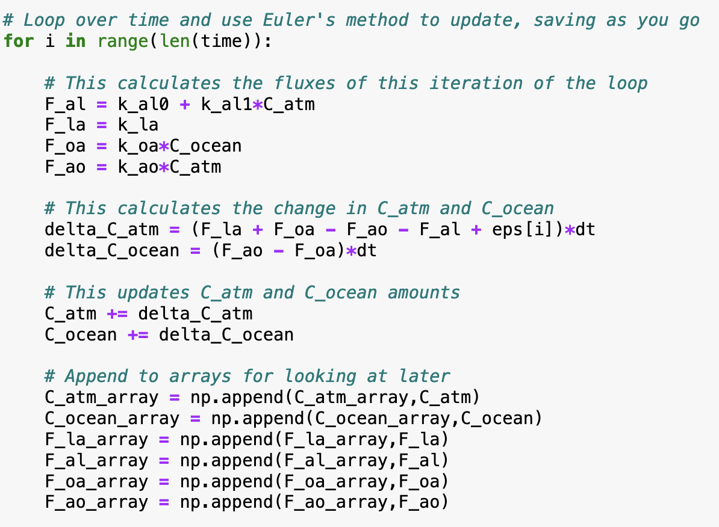
Euler’s Method
Euler’s method …
Is an algorithm for computing atmospheric fluxes
Is an algorithm for computing how dynamic variables evolve over time
Is a method of appending values of time-dependent variables to arrays for looking at later
Is a catch-all phrase describing diagnostic algorithms

Slide 9
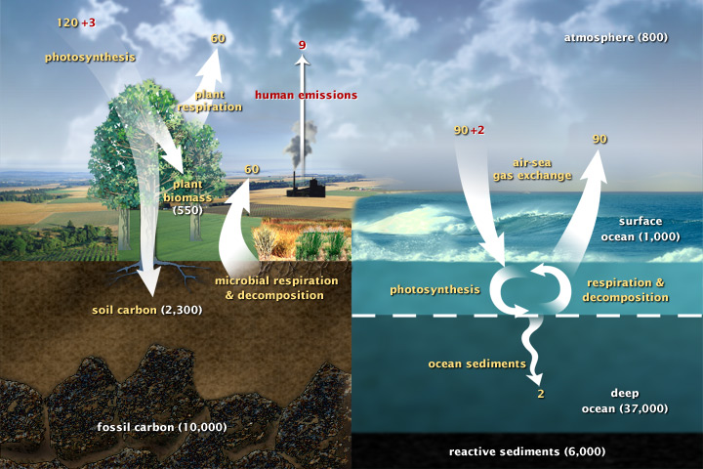
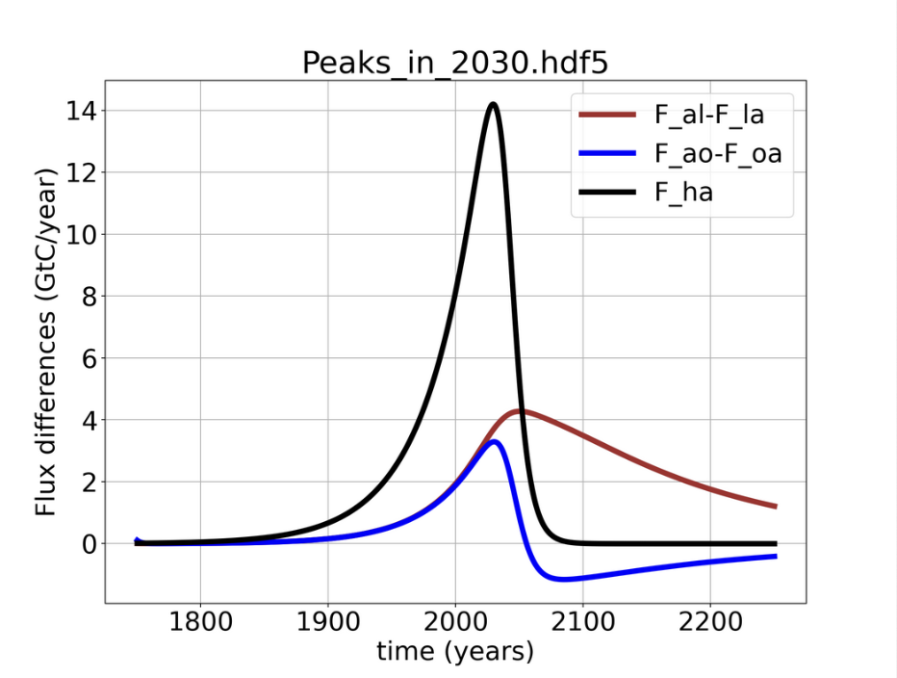
Cambio2.0 fluxes 1
The black curve below corresponds to which flux in the figure at right?
C ↑
D ↓
E ↑
A↓
B↑
F ↓

Slide 10
Cambio2.0 fluxes 2
What does it mean physically, that the blue curve dips below zero?
C ↑
D ↓
E ↑
A↓
B↑
F ↓

Slide 11
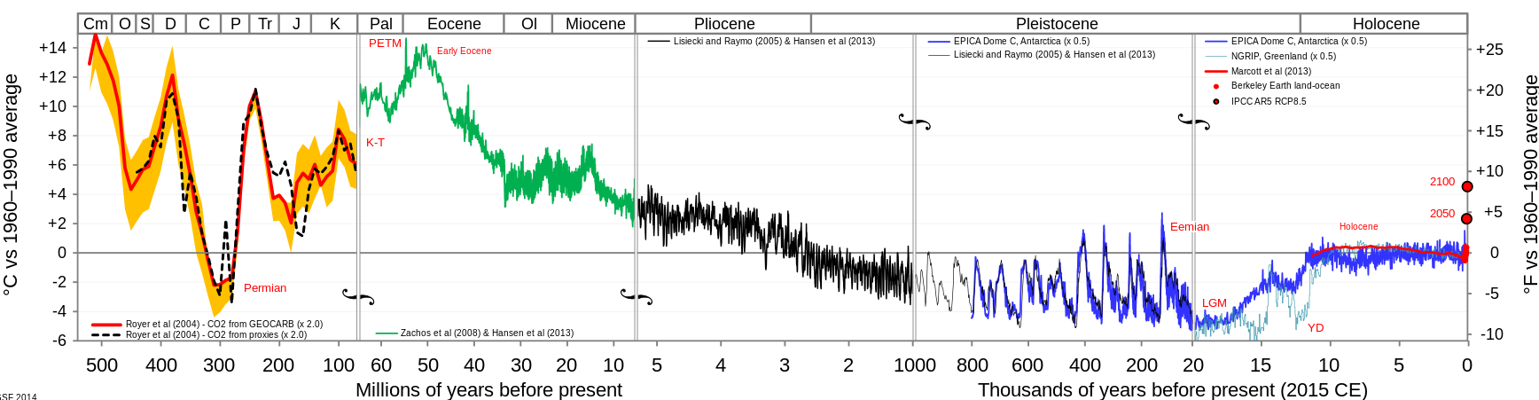
Paleoclimate 1
The drop in temperature starting 50 million years ago is due to …
The destruction of “snowball Earth”
Collision of the India plate with the Asia plate
Milankovitch wobbling
Anthropogenic CO₂ release

Slide 12
Paleoclimate 2
The timing of the ups and downs in the last million years is due to …
The destruction of “snowball Earth”
Collision of the India plate with the Asia plate
Milankovitch wobbling
Anthropogenic CO₂ release

Slide 13

Positive and negative Feedback loops
Identify each cycle below as a positive (self-amplifying) feedback or negative (self-correcting) feedback loop:
Physiology
Climate
Population

Slide 14
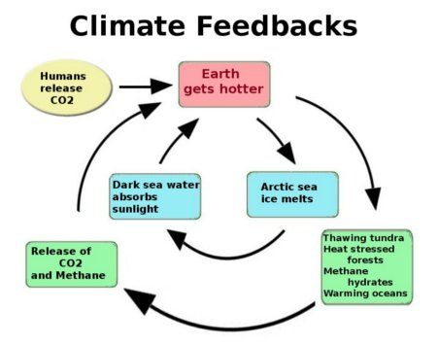
Algorithmic representation of feedbacks 1
Which algorithm addresses the part of the feedback loop shown by the red arrow?

Slide 15
Algorithmic representation of feedbacks 2
Which algorithm addresses the part of the feedback loop shown by the purple arrow?

Slide 16
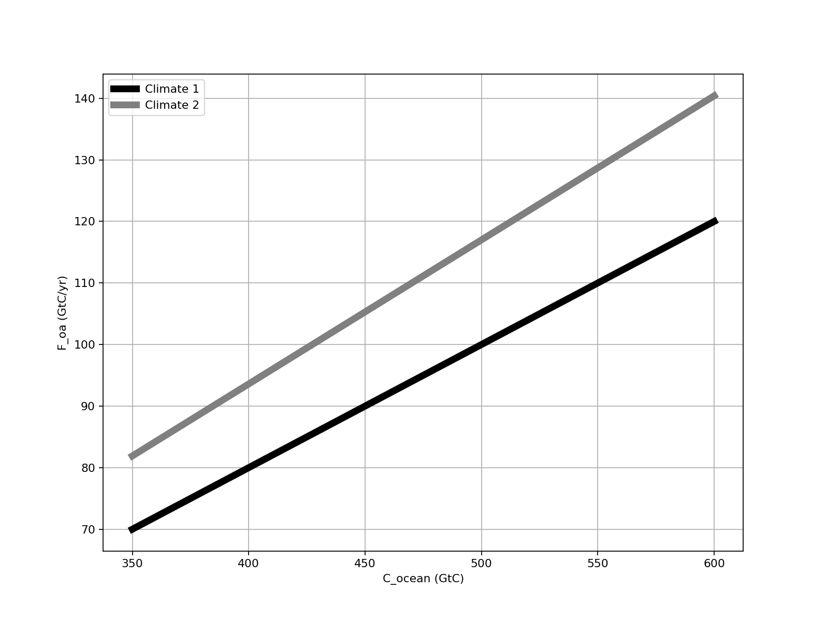
Temperature-dependent ocean feedback 1
The curves below represent carbon flux from the ocean to the atmosphere as a function of ocean carbon, at two planetary temperatures.
↑
Which line represents the behavior of a warmer ocean (and why)?

Slide 17
Temperature-dependent ocean feedback 2
The curves below represent carbon flux from the ocean to the atmosphere as a function of ocean carbon, at two planetary temperatures.
↑
Warmer climate
Cooler climate
Is this feedback good news or bad news, from a climate perspective?

Slide 18
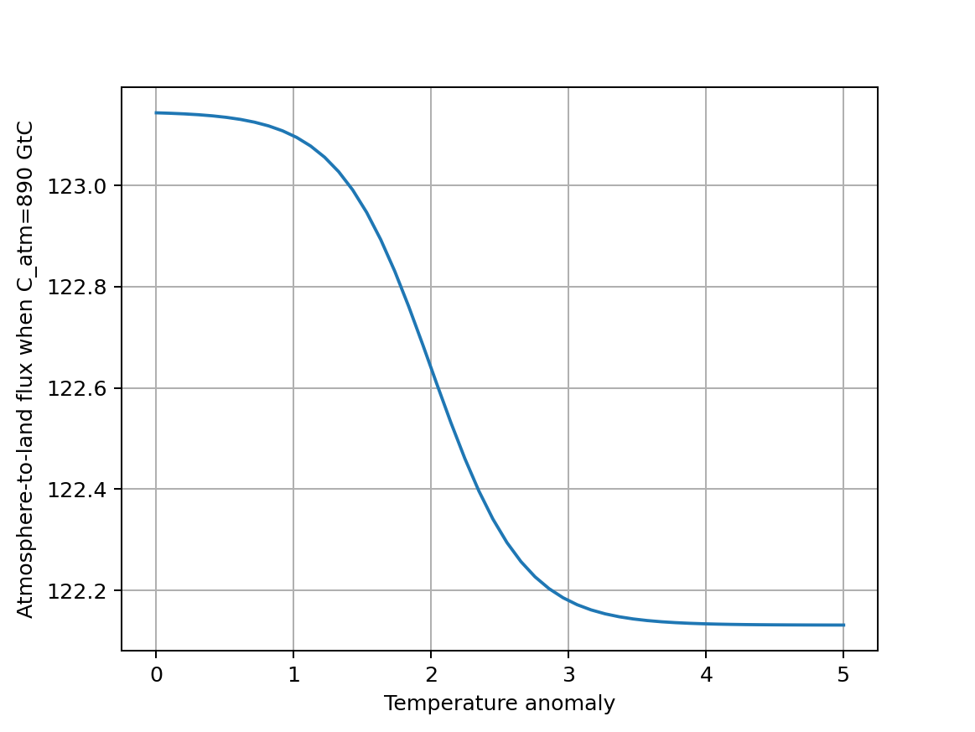
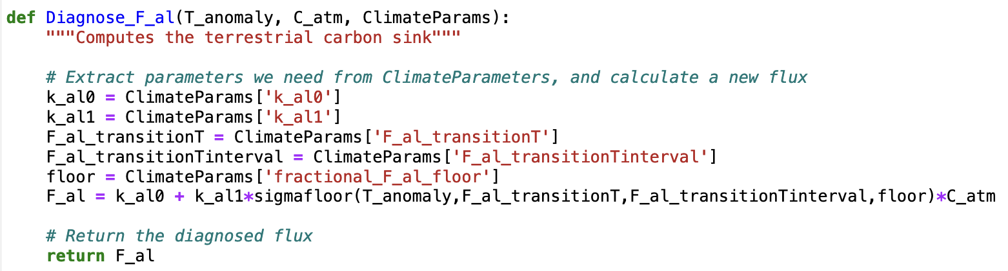
Temperature-dependent atmosphere-to-land feedback 1
The curve below represents carbon flux from the atmosphere to the land as a function of the global temperature anomaly when there’s no feedback (dashed line), and when there is feedback (solid line).
↑
The physical reason behind this reduction is that
We expect more photosynthesis on a warmer planet.
We expect less photosynthesis on a warmer planet.

Slide 19
Temperature-dependent atmosphere-to-land feedback 2
The curve below represents carbon flux from the atmosphere to the land as a function of the global temperature anomaly when there’s no feedback (dashed line), and when there is feedback (solid line).
↑
Is this feedback mechanism good news or bad news, from a climate perspective?

Slide 20
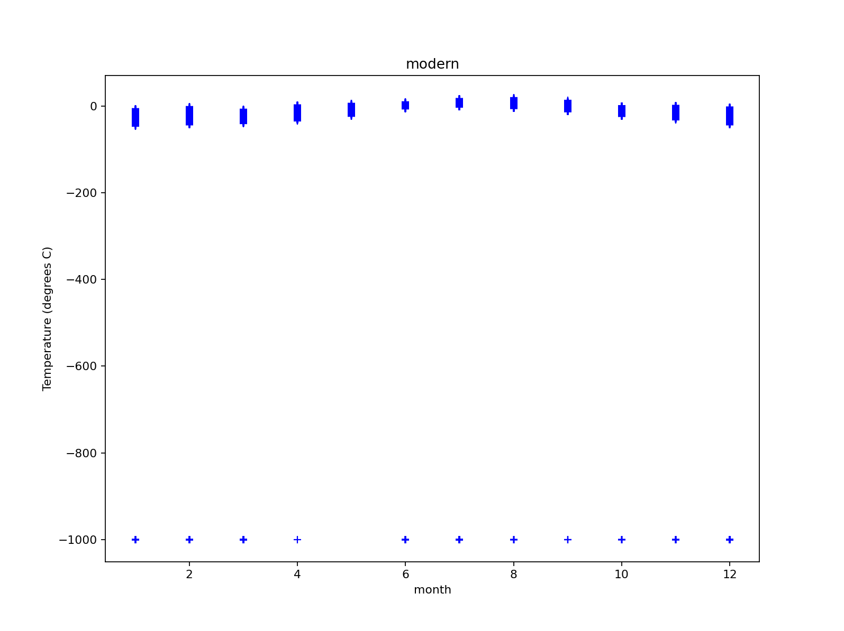
Climate statistics – time series
These data were extracted from the NOAA BRW data archive.
What’s going on here?

Slide 21
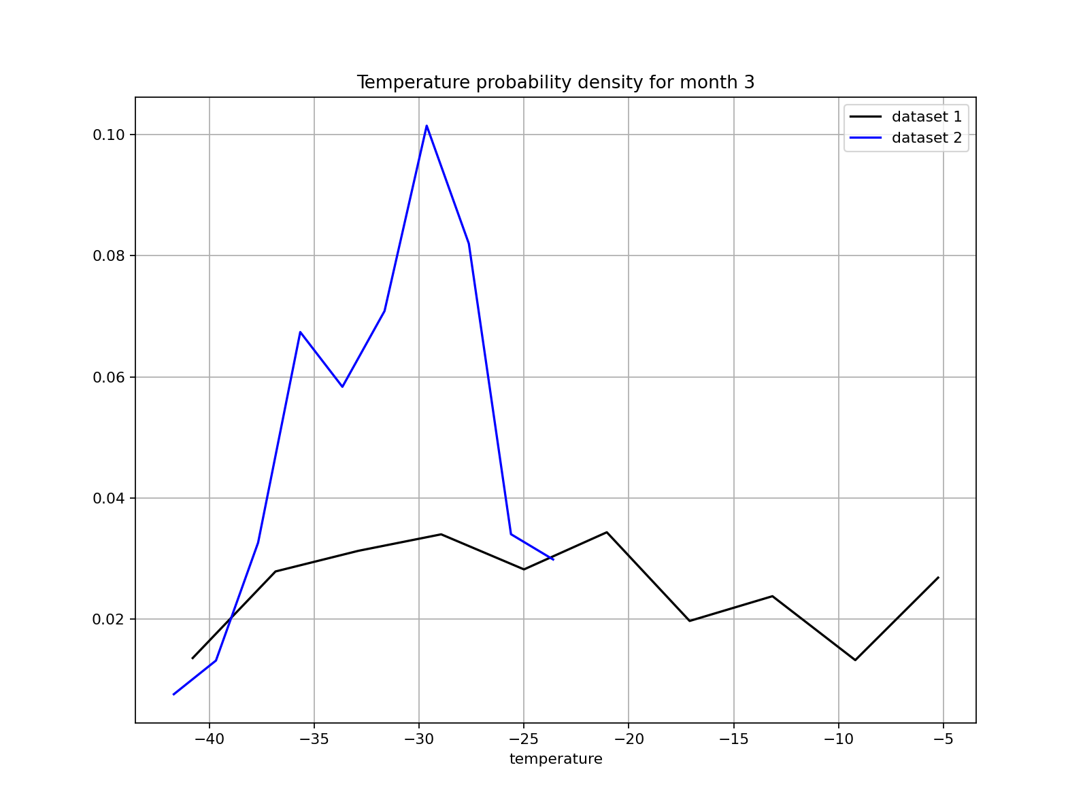
Climate statistics – probability densities
These graphs are based on data from the NOAA BRW data archive, for two different years.
Which dataset seems to indicate greater temperature variability?
Which seems to indicate a warmer climate?
What key limitation to these inferences is a climatologist most likely to point out?

Slide 22
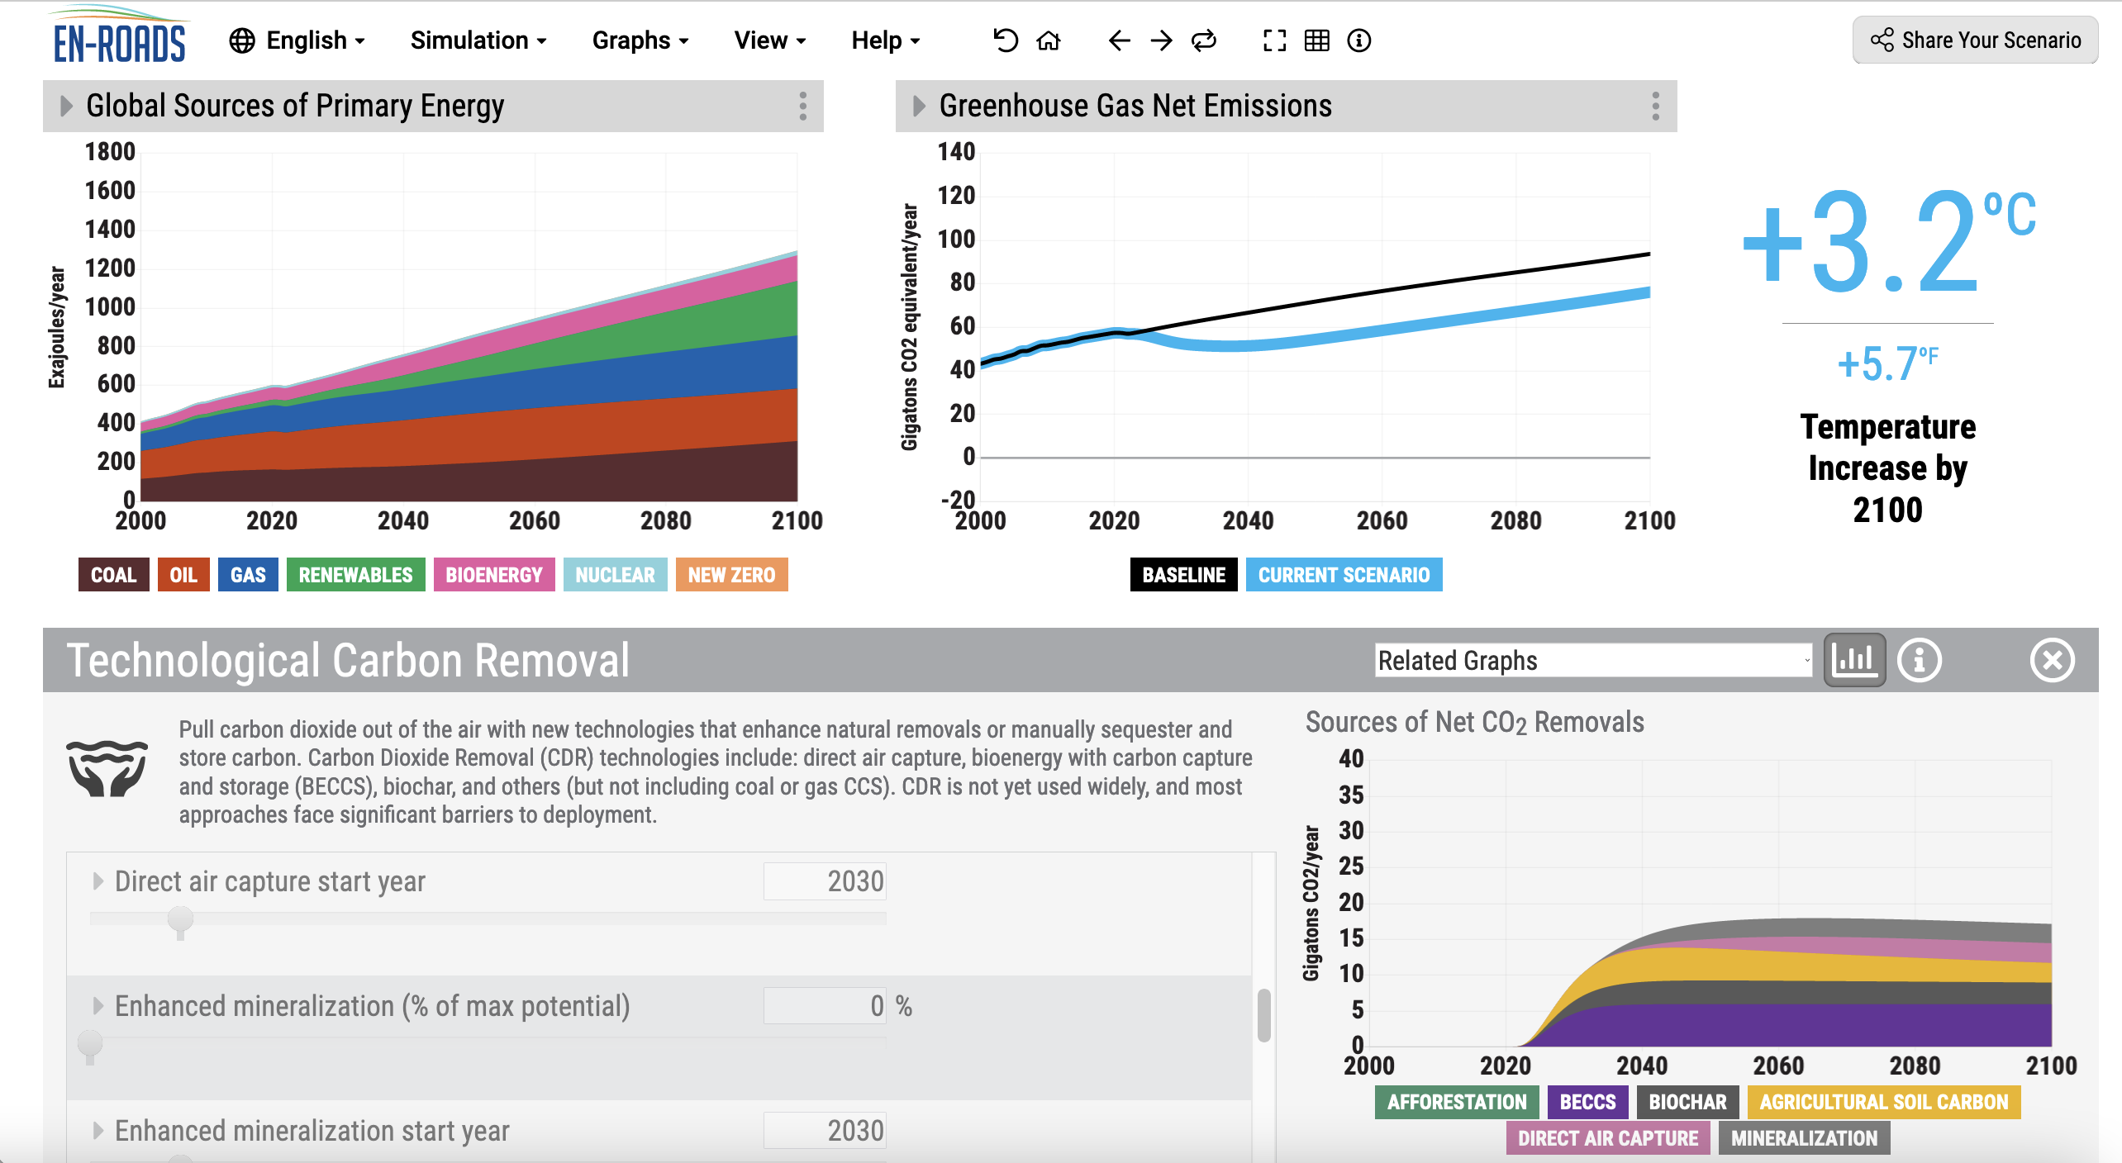
EnROADS & Cambio
Which would be the most faithful implementation of the EnROADS’ carbon removal scenario shown at right, in a (future) Cambio4.0?
Increase the tipping point threshold (like F_al_transitionT) to a higher temperature
Multiply the anthropogenic scheduled emissions (F_ha) by a sigmafloor-type function that kicks in around the year 2030
Subtract from the anthropogenic scheduled emissions a sigmafloor-type function that kicks in around the year 2030
Decrease the climate sensitivity parameter (CS in ClimateParams)

